Slide 1
Effective Threat Modelling
Andrea Jones @allaboutclait
Andrea Jones – Bsides Leeds 2025

Slide 2
A bit about me
Started using computers in the days before Windows.
Over 10 years doing information security in public and private sector.
Currently working for Sainsbury’s as a Lead Information Security Analyst.
Regularly use threat modelling to assess mainly cloud-based architecture.
X: @allaboutclait
This presentation contains my personal views and not those of my employer.
Notes:
Had some good results and want to share my thoughts

Slide 3
The Symptoms of Misconfiguration
Vulnerability scans highlighting weak, or non-existent, encryption, weak authentication methods, unnecessary public IPs, etc.
Cloud consoles listing reams of issues for resources, e.g. publicly exposed storage.
Penetration testers find basic flaws.
Scans find exposed credentials or weak Active Directory configuration.
Notes:
Although an attacker’s not going to exploit every single weakness your vulnerability scans are highlighting, it’s probably true that the more you have, the more likely you are to be breached. It’s also a metric most organisations are likely to use to assess their security posture.
Alert fatigue – having all these vulnerability notification means it’s easy to start ignoring them and ones that really should be investigated can disappear like a needle in a haystack.

Slide 4
These Vulnerabilities Often Lead To Real Impacts
Cloud Security Alliance Top Threats to Cloud Computing report 2025 found the top issues in recent breaches were:
Misconfiguration and Inadequate Change Control
Identity and Access Management
Insecure Software Development
Insecure Interfaces and APIs
Inadequate Selection/Implementation of Cloud Security Strategy
System Vulnerabilities
Notes:
Here are some real examples of breaches due to weak configuration, etc.

Slide 5
Recent Breaches Disclosing the Most Personal Data
T-Mobile – GPRS gateway on public internet and successful brute forcing of SSH on router
Xfinity – Unpatched critical Citrix flaw
PeopleConnect, Inc – exposed database
NationStar Mortgage – Unsecured Google Cloud storage bucket

Slide 6

Your Shiny Architecture Comes With Free Vulnerabilities
Sadly, security is not always default.
Notes:
Now, you would hope that cloud, SaaS and PaaS providers would provide certain secure defaults when you create a new instance. Sadly it seems more often than not this isn’t the case.
Too secure become unusable.

Slide 7
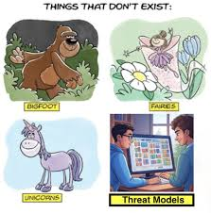
We Use Threat Modelling, Right?

Slide 8

The Doomed Temple of Temporal Trade-Offs
The root cause of most technical debt
Notes:
There’s a fundamental human problem behind a lot of less than optimally designed infrastructure. If I ask you whether you want £500 now or £2000 in 2 years’ time what are you going to take?
I did some research into why developers don’t attempt to save cost when they’re building infrastructure
Developers don’t put effort in to build secure or cost-effective systems due to temporal trade-offs. This is why we don’t create secure or cost-effective infrastructure from the start.
Vulnerabilities create technical debt which is then costly and time-consuming to remediate. I have found it useful to deliver the best practice to developers and have found it’s more likely they will then implement it. Also, as they use these configurations they become more likely to get them right next time. Practice makes (almost) perfect.
I’m now going to demonstrate Microsoft’s free Threat Modelling Tool and show you how you can use it to give you a head start on the threat modelling process.

Slide 9
Threat Modelling Process
What are we building?
What could go wrong?
Mitigating controls
Did we do a good enough job?

Slide 10
Data Flow Diagram
Semantic Search
Document Store
Query
Indexing information
Question
Web Application
Employee
Relevant information
Result
Prompt and relevant information
LLM
Response returned
For more information see https://owasp.org/www-community/Threat_Modeling_Process#data-flow-diagrams

Slide 11
Threat Modelling Comes in Different Sizes
STRIDE – Simple for smaller organisations or getting started
DREAD – More quantitative, good for working out ‘how bad is it?’
PASTA – More comprehensive for those with more resources and experience.

Slide 12
STRIDE
Spoofing – Controls ensure suitable authentication
Tampering – Controls ensure integrity
Repudiation – Controls help avoid non-repudiation
Information Disclosure – Controls ensure confidentiality
Denial of Service – Controls ensure availability
Elevation of Privilege – Controls ensure authorisation
Notes:
Sometimes there are issues working out where something should sit. Are poorly secured secrets an information disclosure risk or a spoofing risk?
How do you classify a vulnerability exploitable by malware – tampering?
Sometimes a ‘LM’ category for lateral movement is added to stride, this can be used to cover network segregation etc.

Slide 13
DREAD
Damage potential – Attack impact
Reproducibility – How easy is it to reproduce?
Exploitability – How easy is the attack to launch?
Affected users – How many users will it affect?
Discoverability – How easily can the vulnerability be detected?
Notes:
Sometimes there are issues working out where something should sit. Are poorly secured secrets an information disclosure risk or a spoofing risk?
How do you classify a vulnerability exploitable by malware – tampering?
Sometimes a ‘LM’ category for lateral movement is added to stride, this can be used to cover network segregation etc.

Slide 14
Application of STRIDE to Trust Boundaries
 | S | T | R | I | D | E
External Entity | ✓ |  | ✓
Process | ✓ | ✓ | ✓ | ✓ | ✓ | ✓
Data Store |  | ✓ | ? | ✓ | ✓
Data Flow |  | ✓ |  | ✓ | ✓

Slide 15
PASTA
Process for Attack Simulation and Threat Analysis
Define objectives
Identify boundaries, technologies and data flows
Visually represent the components and relationships
Identify potential threats
Analyse identified threats against the system’s weaknesses
Simulate potential attacks
Analyse risk and impact
Notes:
Sometimes there are issues working out where something should sit. Are poorly secured secrets an information disclosure risk or a spoofing risk?
How do you classify a vulnerability exploitable by malware – tampering?
Sometimes a ‘LM’ category for lateral movement is added to stride, this can be used to cover network segregation etc.

Slide 16
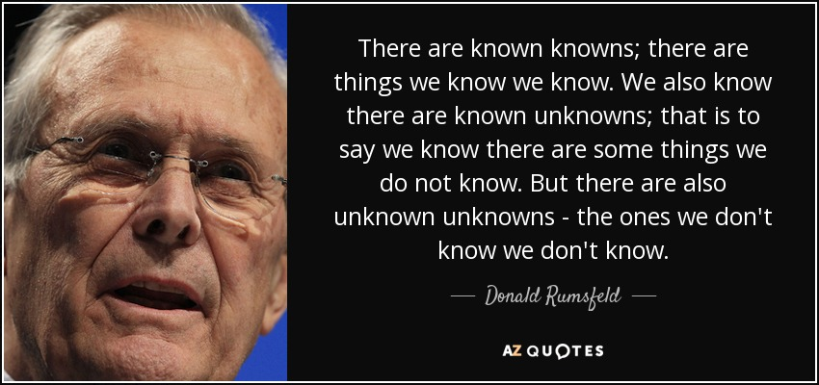

Slide 17

The Problem
Known
Unknown
Known
The Known Knowns Good encryption Single sign-on / Open ID Connect Secrets management Other stuff developers do day in, day out | The Unknown Knowns Full details of best practice configuration Other stuff developers aren’t aware of (this is then surfaced in subsequent penetration tests).
The Known Unknowns Zero days / new vulnerabilities Human error | The Unknown Unknowns
Unknown
Notes:
I think one of the problems we have with threat modelling is the difficulty we have identifying or remembering what can go wrong. Also there are some things we know are likely to happen, we just don’t know exactly how (although we may expect them more from some manufacturers than others).
Known knowns are things developers or security analysts know to sort off the top of their heads.
Unknown knows are those things which are documented out there but nobody’s rummaged through it to find what’s needed.
Known unknowns are things we know regularly happen but are harder to mitigate
Unknown unknowns are the black swans, the totally weird – such as Simon Painter speaking at the same time as me in Leeds.
There’s also a saying ‘The more you know, the less you know’, as your knowledge grows you appreciate more of what you don’t know. There’s also the Dunning-Kruger effect where some people may overestimate their abilities and miss things while others may suffer from a kind of imposter syndrome because they realise there’s probably more they don’t yet understand.

Slide 18
Sources of Inspiration
Your organization’s policies and procedures
SaaS / PaaS / IaaS Provider Best Practice
MITRE CAPEC – mapped to STRIDE on Brett Crawley’s ostering.com blog
Previous incidents
Your in-house red team
Commercial tooling

Slide 19
Links for Security Baselines, etc.
Azure Security Baseline: https://github.com/MicrosoftDocs/SecurityBenchmarks/ (See ‘Azure Security Offer’ folder)
AWS Security Documentation: https://docs.aws.com/security
MITRE CAPEC Mechanisms of Attack: https://capec.mitre.org/data/definitions/1000.html
CAPEC – STRIDE mapping: https://ostering.com/blog/2022/03/07/capec-stride-mapping
AWS Config Mapping to NIST 800-53 Rev.5: Operational Best Practices for NIST 800-53 rev 5 - AWS Config
Github for AWS Config: https://github.com/awslabs/aws-config-rules/blob/master/aws-config-conformance-packs/

Slide 20
Some relevant elements from the Threat Modelling Manifesto
A culture of finding and fixing design issues
Repeatability and measurability
Achieve thoroughness and reproducibility by applying security and privacy knowledge in a structured manner
Threat modelling must align with an organization’s development practices and follow design changes
Improving security and privacy through early and frequent analysis
Notes:
Even if you’re a small organization or not an expert threat modeler, get started and have a go using best practice to help you develop some threats and mitigations.
Best practice can really help with the repeatability part and is likely to result in being able to measure through reduced configuration vulnerability detections.

Slide 21
Resources for Creating Templates
Microsoft Threat Modelling Tool: https://aka.ms/tmt
Azure Architecture Icons: https://learn.microsoft.com/en-us/azure/architecture/icons/
AWS Architecture Icons: https://aws.amazon.com/architecture/icons/

Slide 22

Thank you, and happy threat modelling!
Download Slides and other resources
Work at Sainsburys:
https://www.sainsburys.jobs

